Slide 1

CaPSTONE PROJECT BATTLE OF THE NEIGHBORHOODS Final project
Daniel E. Rivero MendozA
June 2020

Slide 2
BACKGROUND
This Capstone Project - Battle of the neighborhoods aims to leverage the tools and techniques learned over the past few months in the IBM Data Science Professional Certificate to answer if Data Science tools can be used to help in some of the aspects of having to move. The aim is to suggest moving to the “right place” by providing an approach and methodology to find neighborhoods with desired characteristics and attributes, assuming the more familiar and comfortable it feels @ destiny the better-off anybody will be. The case of study is a hypothetical move from Boulder (CO, United States) to Sydney (NSW, Australia), two cities halfway across the world, with very different landscapes, but perhaps more similar than anybody would think at first glance.

Slide 3
Problem to be solved
The problem to solve is finding a neighborhood in Sydney (NSW, Australia) with similar characteristics to one in downtown Boulder (CO, United States), plus some extra attributes. Thus, to set the basis for comparison, the following are applicable to the neighborhood at destination:
Must haves:
Surroundings with amenities and venues like the ones found in Boulder (CO), USA
Located within 2 km from a train or light rail station in greater Sydney (NSW), Australia
Desirable, pending availability of time and reliable data:
Rent price in the 500 AUD/week range for a unit with at least 2 bedrooms, 1 bathroom, 1 parking spot, and 75 sqm.

Slide 4
DATA REQUIRED
To establish compliance of neighborhood(s) @ destination with the list of attributes in Section 1.2., the following data is needed.
- Coordinates for downtown Boulder, CO - Source: Nominatim tool from geopy.geocoders
- List of top venues in downtown Boulder, CO. - Source: API call to access Foursquare data (name, coordinates, type, etc.) on venues @ given locatio
- List of suburbs in Sydney, NSW. - Source: Scraped from the website http://www.walksydneystreets.net/suburbssydneyall.htm
- Coordinates for the suburbs in Sydney, NSW. - Source: Nominatim tool from geopy.geocoders., based mostly on the list of neighborhoods outlined above.
- GEOJSON data for suburbs in Sydney, NSW. - Source: File with all the 4000+ neighborhoods in New South Wales, Australia, downloaded from federal government site https://data.gov.au/data/dataset/91e70237-d9d1-4719-a82f-e71b811154c6
- List of Train Stations in Sydney, NSW. - Source: File with all the train and light rail stations in New South Wales, Australia, downloaded from the OpenData portal from the local government site https://opendata.transport.nsw.gov.au/dataset/train-station-entries-and-exits-data
- Coordinates of Train Stations in Sydney, NSW. - Source: See above.
Time and reliability of data permitting, the following dataset is needed to establish compliance of neighborhoods @ destination with desired attributes for rental units.
- Average rental price and characteristics of units per neighborhood in Sydney, NSW. - NOTE No reliable data was found in time for this.

Slide 5
METHODOLOGY
The data outlined above will be used as follows:
- Coordinates for downtown Boulder will be used to retrieve top venues in 5 km radius _via_ FourSquare.
- Charts and maps to be used to visualize the data.
- List of suburbs in Sydney will be used to retrieve the geographic coordinates _via_ geopy, which will be complemented with data from the GEOJSON.
- List of Train Stations and their coordinates in Sydney, NSW, will be used to filter out suburbs(s) with centres further than 2 km.
- Maps to be used to visualize the data.
- List of venues in Boulder and Sydney will be used to establish similarities between their corresponding suburbs.
- Charts to be used to explore the data and look for correlations.
- Maps to be used to depict the data.
- kMeans algorithm to be used in order to categorize the suburbs in Sydney and Boulder, which will pair the latter with one or several suburbs in the former based on the venues available close by.
- Additional metrics to be used as fit to figure out the list of suburbs that are suitable for moving in Sydney.

Slide 6
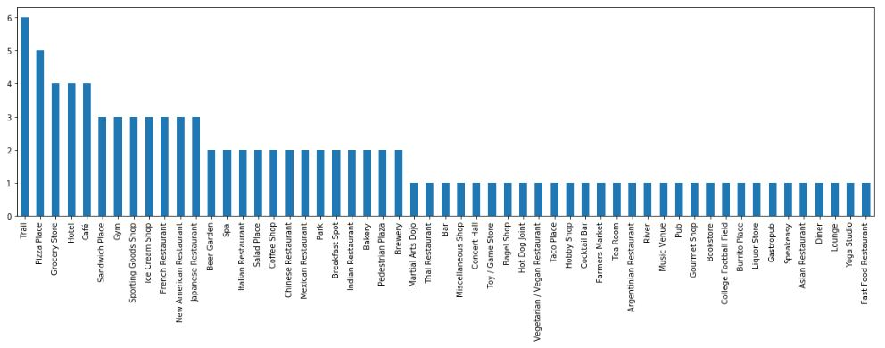
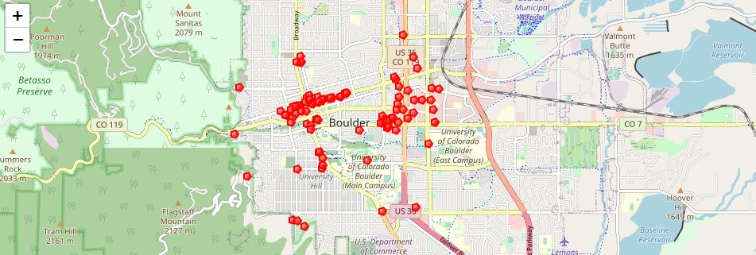
RESULTS AND ANALYSIS
List and category breakdown of venues in Boulder, CO.
Geographical distribution of venues retrieved in Boulder, CO.

Slide 7
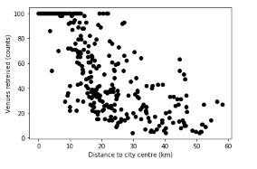
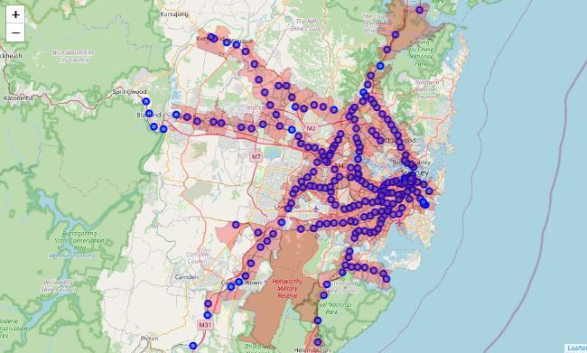
RESULTS AND ANALYSIS
Number of places retrieved via FourSquare for Sydney, NSW. vs. distance to Sydney centre.
No correlation observed.
Map of Sydney with train stations (blue) and suburbs < 2km from a train station.

Slide 8
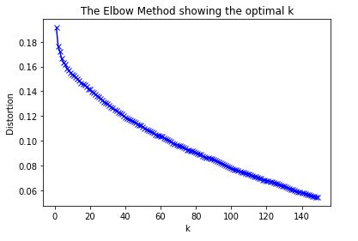
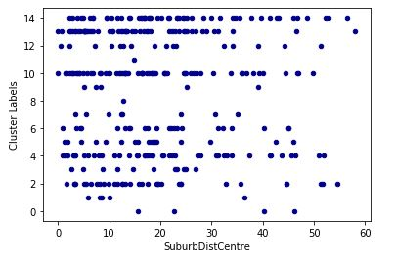
RESULTS AND ANALYSIS
kMEANS distortion plot as a function of cluster number
Optimum cluster number set at 15
Cluster number vs. distance to city centre
Clustering not dependent on distance

Slide 9
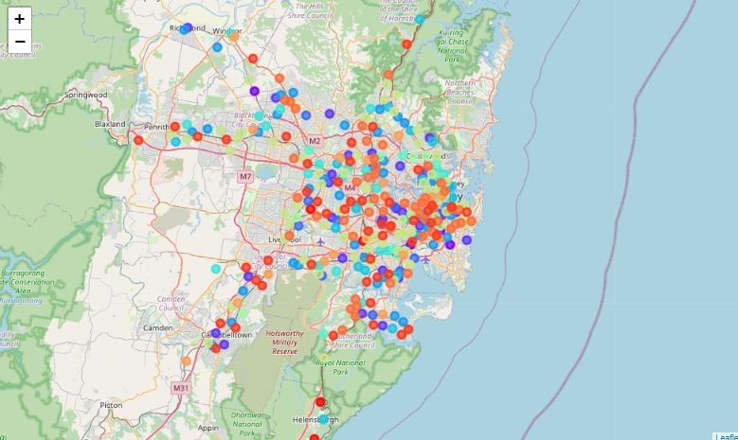
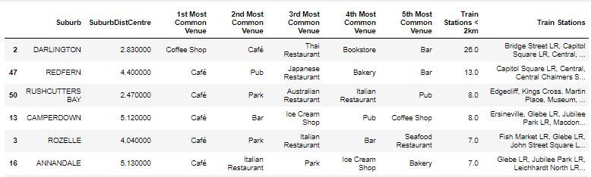
RESULTS AND ANALYSIS
Map of Sydney with suburbs color coded per cluster
Cluster 13 with similar attributes as Boulder, CO – parks and gyms featuring in most common venues, along with cafes, bars and restaurants
Table with Sydney suburbs like Boulder, CO, and within 2km of a train station
Darlington, Redfern, Rushcutters Bay, Camperdown and Rozelle are suggested as places to move.

Slide 10
Conclusion
To conclude, the data analysis was performed to identify the suburbs in Sydney with train or light rail stations within 2km and venues/ammenities similar to downtown Boulder, CO. During the analysis, several suburb and venues/ammenities features were explored and visualized. Furthermore, clustering helped to find a list of suitable moving suburbs

